Slide 1
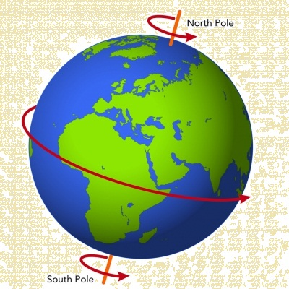
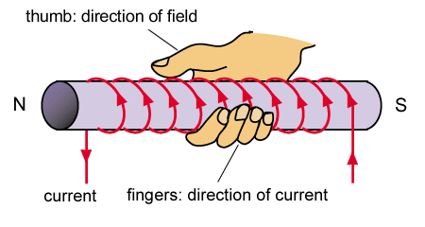
S
N
Actuators – 3.2
Basics of Magnetism
FY – DESH – VIT
Vishwakarma Institute of Technology
FY - Department of Engineering, Sciences and Humanities

Slide 2
The Earth – Magnetism - Poles
Why the Earth shows Magnetic properties ?
Where is Magnetic North Pole of Earth ?
Where is the Magnetic axis ?
Is Geographical axis same as Magnetic axis ?
Vishwakarma Institute of Technology
FY - Department of Engineering, Sciences and Humanities
Are both axes matching ?
What is the exact location of Magnetic Poles of Earth ?
Try these questions –
Just as a curiosity !

Slide 3
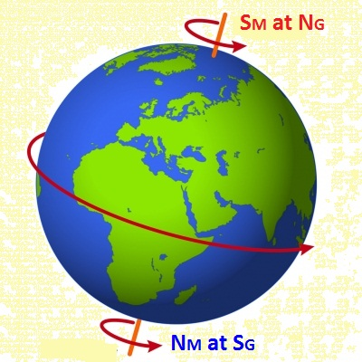
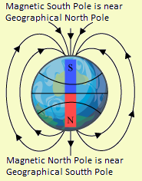
Earth as a huge Magnet .....
Vishwakarma Institute of Technology
FY - Department of Engineering, Sciences and Humanities
The Earth is a huge Magnet with its
Magnetic North pole at its Geographical South pole
and vice versa .....

Slide 4
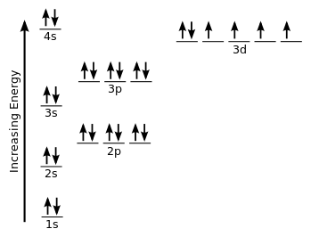
The origin of Magnetism
Electronic Configuration of Iron
Vishwakarma Institute of Technology
FY - Department of Engineering, Sciences and Humanities
Electron Spin
The number of unpaired electrons and their CW or CCW spins are mainly responsible for the Magnetism along with the crystal structure.

Slide 5
Properties of Magnetic Lines of Force -
1) Magnetic lines are invisible, imaginary lines which are somewhat elliptical in shape which never cross eachother.
2) Magnetic lines are closed loops that are supposed to travel from North pole of a bar magnet towards the South pole external to the magnet and from South pole towards the North pole internally.
3) Magnetic lines that are parallel and travelling in the same direction, REPEL eachother.
Vishwakarma Institute of Technology
FY - Department of Engineering, Sciences and Humanities
4) Magnetic lines act like stretched rubber band which always try to contract.
5) Magnetic lines prefer a path of minimum reluctance.

Slide 6
Concept of Orientation of Magnetic Flux in a material -
S
N
N
S
Vishwakarma Institute of Technology
FY - Department of Engineering, Sciences and Humanities
S
N
S
N

Slide 7

Match the pairs
A
B
1) Left hand rule
A) Generating action
2) Right hand thumb rule
B) Motoring action
3) Right hand rule
C) Direction of magnetic field due of current
Vishwakarma Institute of Technology
4) Right hand grip rule
D) Magnetic attraction
FY - Department of Engineering, Sciences and Humanities
5) Left hand screw rule
E) Lenz’s Law
6) Fleming’s Left hand rule
F) Faraday’s 2nd Law
7) Fleming’s Right hand rule
G) Faraday’s 1st Law

Slide 8
Cross conductor
Dot conductor
Will the two conductors attract or repel ?
Vishwakarma Institute of Technology
FY - Department of Engineering, Sciences and Humanities
…. And what about this …?

Slide 9
Attraction or Repulsion is a property of the direction of magnetic lines
Cross conductor
Dot conductor
Lines that are travelling in the same direction REPEL eachother
The conductors will get repelled
Vishwakarma Institute of Technology
FY - Department of Engineering, Sciences and Humanities
The conductors will get attracted
Lines that are travelling in the opposite direction ATTRACT eachother

Slide 10
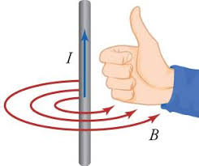

Right Hand Thumb Rule
Vishwakarma Institute of Technology
FY - Department of Engineering, Sciences and Humanities
Which one of the above is correct ??
Thumb is for Current or Field ??

Slide 11
Important terms related to Magnetism -
Magnetic Permeability ( μ ) : It is the property of a material to allow the magnetic line of force to pass through it.
Unit is Henry per meter ( H / meter)
Relative Permeability : It is just a ratio for comparison
μ of the material
μ r = --------------------------- (∴ No unit)
μ of air or vacuum
A good ferromagnetic material is about 800 to 1200 times better than air.
Vishwakarma Institute of Technology
FY - Department of Engineering, Sciences and Humanities
Value of μr for air = ??

Slide 12
Important terms related to Magnetism -
Magneto Motive Force MMF ( F ) : (Similar to EMF)
F = No. of Turns x Current through them
F = N x I Unit = Amp-Turns (OR Amp)
Magnetic Flux Density ( B ) :
Flux Weber
B = ------- Unit is Tesla ( T ) = ---------------
Area Sq. meter
Vishwakarma Institute of Technology
FY - Department of Engineering, Sciences and Humanities
Magnetic Field Strength OR
Magnetic Field Intensity OR
Magnetising Force ( H ) : MMF reqd. per meter length
Unit is Ampere-Turns per meter ( Amp / meter)

Slide 13
Important terms related to Magnetism -
MMF (F) Amp x Turns
Flux (φ) = -------------------- = -----------------------
Reluctance (s) (1 / μ) x ( l / a)
I N
Flux (φ) = --------------------
(1 / μ) x ( l / a)
φ l
From above we get , μ = ----------
I N a
Vishwakarma Institute of Technology
FY - Department of Engineering, Sciences and Humanities
We know that, H = B / μ
φ I N a I N
Substituting for B and μ , H = --- x --------- = --------
a φ l l
Thus, H is a function of the Current I which produces the Flux φ ........ H α I

Slide 14
Flux density B
C
OD = Retaintivity
(Residual Magnetism)
Saturation
B
D
Linear rise
Magnetism lost
A
Sluggish start
E
O
H
Magnetising
Force H
Vishwakarma Institute of Technology
FY - Department of Engineering, Sciences and Humanities
OG = Retaintivity
(Residual Magnetism)
G
F
Saturation
B-H Curve Hysteresis Loop

Slide 15
Flux density B
C
B
D
A
E
O
H
Magnetising
Force H
Vishwakarma Institute of Technology
FY - Department of Engineering, Sciences and Humanities
G
B-H Curve
Hysteresis Loop
F

Slide 16
Comment on all the curves -
1
2
5
Vishwakarma Institute of Technology
FY - Department of Engineering, Sciences and Humanities
3
4

Slide 17
Home work –
1) Draw graph of IDEAL magnetic material
Vishwakarma Institute of Technology
FY - Department of Engineering, Sciences and Humanities
2) Is a good conductor, magnetic in nature ?
3) Is a good magnetic material, a conductor ?
4) What is Curie temperature ?
5) Write on similarities and differences between Electrical and Magnetic circuits

Slide 18
S
N
Actuators – 3.2
Thanks !
Basics of Magnetism
FY – DESH – VIT
Vishwakarma Institute of Technology
FY - Department of Engineering, Sciences and Humanities

